Slide 1


Titolo presentazione sottotitolo
A complex network perspective on Drug Prediction
Milano, XX mese 20XX
Luca Muscarnera 10539305
Prova integrativa COMPLESSITÁ NEI SISTEMI E NELLE RETI

Slide 2
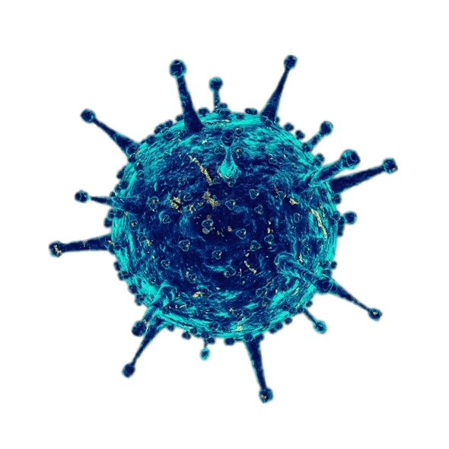

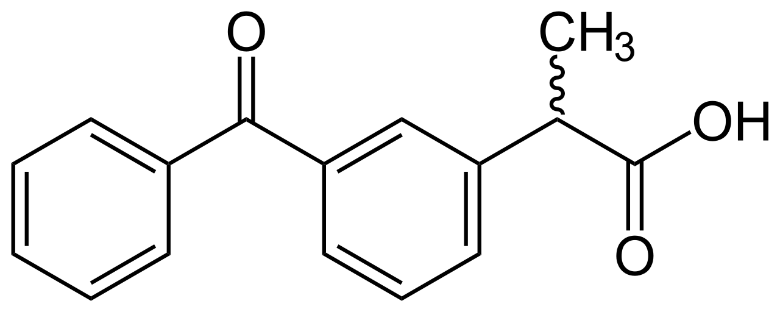
Drug discovery as a quantitative problem
(Computer aided) Drug discover can be seen as the process of using computation in order to discover previously unknown interaction between a certain set of diseases and a certain set of chemicals.
(we are here)
?
What is causing interaction between some diseases and some chemicals? How can we effectively exploit the information hidden in this interaction?

Slide 3
Our Dataset
We focus on the bipartite network Disease-drug association network, hosted by SNAP
The dataset offers a representation of the interaction between diseases and chemicals, without providing any further information a part from the ids (and types) of the nodes
We have to rely only on topology in order to extract knowledge
Reduced visualization of the network

Slide 4
Our Dataset (some statistics...)
Low density and lack of metadata make this problem inherently hard.
Statistics
The much higher probability for a link to not exists makes statistically challenging to infer the existence of a link

Slide 5
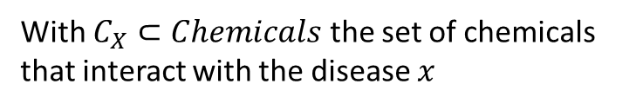
An agnostic approach on topological similarity between Diseases
A first approach was based on inducing a metric of similarity between diseases and then using it to perform collaborative filtering
$$S_{ab}=\left|C_{a}∩C_{b}\right| ∀a,b∈Diseases$$
With $C_{X}⊂Chemicals$ the set of chemicals that interact with the disease $x$
Heuristically, we model the similarity among diseases as the tendency to interact with the same chemicals. The spectrum of information that describes each diseases is then implicitely defined solely based on their interactions
Do diseases really «choose» chemicals, in the same way human beings choose products?
Are we neglecting some piece of information?

Slide 6
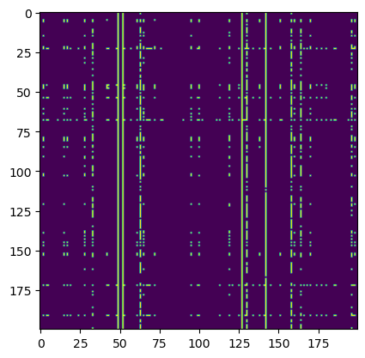
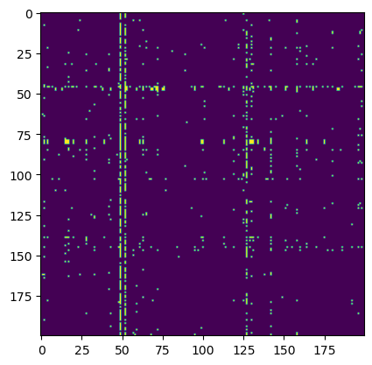
An agnostic approach on topological similarity between Diseases
Applying collaborative filtering we obtain an expression for the Predicted Biadjacency Matrix
$${\hat{B}}_{ij}=\frac{\sum_{k}{S_{ik}B_{kl}}}{\sum_{k}{S_{ik}}}$$
Unfortunately, this is shown insufficient in capturing the dynamics of the phenomena that generate the network
Predicted
Ground truth
Captures part
Of the information
But in a «underfitted» way

Slide 7
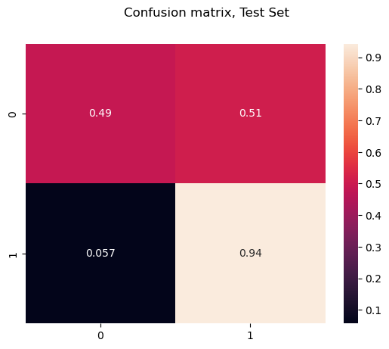
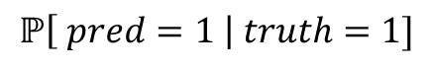
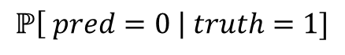
Some metrics on why topological based similarity is NOT enough
$$ℙ\left[ pred=0 \right| truth=1]$$
$$ℙ\left[ pred=1 \right| truth=1]$$
If we restrict to positives, we are not doing better than a random classifier...

Slide 8
The need a more robust modellistic approach
Commuting methods thought for being used on human people was not able to deal with this kind of problem. We need to build a model which is more «thight» with respect to our problem
Information packet

Slide 10

Firma convenzione Politecnico di Milano e Veneranda Fabbrica del Duomo di Milano
Inserimento secondo logo
Fare clic per modificare lo stile del titolo
Fare clic per modificare lo stile del sottotitolo dello schema
Aula Magna – Rettorato
Mercoledì 27 maggio 2015

